Slide 1
Bankbot

Slide 2
Objective:
To create a bot using Natural Language Processing and deep learning which will be able to give answers for various banking related issues like your bank id, transaction details, Security services, loan policies, your account status etc.
Benefits:
App can give answers to all your banking related queries.
Keep you updated with your transaction activity so any kind fraud can be avoided.
Also give you alert signs if find any suspicious activity in your account.

Slide 3
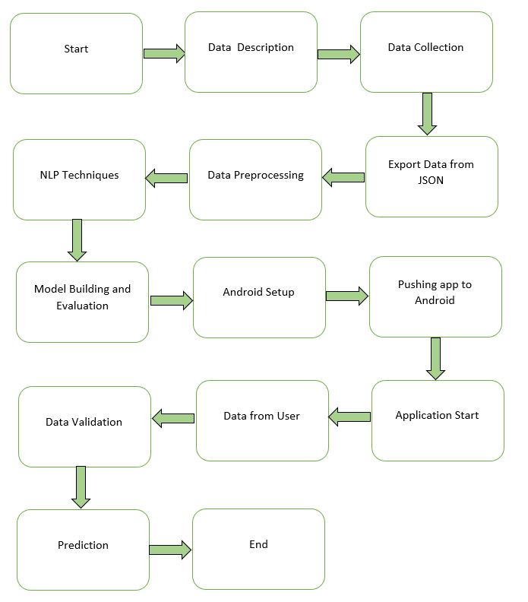
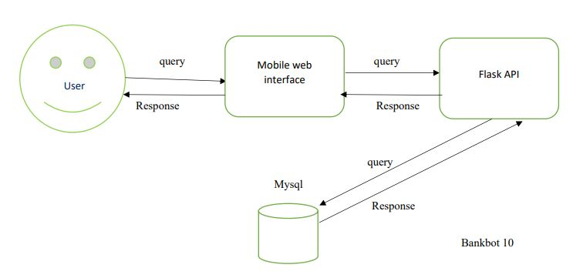
Architecture

Slide 4
Model Training:
Data Export:
The json file is exported in csv format for model training.
Data Preprocessing
Text Preprocessing steps involved lowering text, word tokenization, removal of stopwords, removal of punctuations, stemming, TFIDF Vectorizer.
Encode the categorical values with numeric values.

Slide 5
Model Building –
After the Text Preprocessing Steps. We trained Deep Learning model with 3000 epochs with batch size 8. The model gives 95.68% accuracy.

Slide 6
Model Deployment and Prediction:
The model is deployed on the Cloud-based platform.
Pushing application to the Android.
Data has been taken from the user.
Data Validation and Data Pre-processing techniques are applied.
Predicting the result.

Slide 7
Q & A:
Q1) What’s the source of data?
The data for training is provided by Github.
Q 2) What was the type of data?
The data was a combination of Texts and Categorical values.
Q 3) What’s the complete flow you followed in this Project?
Refer slide 3rd for a better Understanding

Slide 8
Q 5) How are logs managed?
We are using different logs as per the steps that we follow in Data Insertion, Model Training log, prediction log etc.
Q 6) What techniques were you using for data pre-processing?
Lowering texts, word tokenization
Removal of stopwords, removal of punctuations, stemming, TFIDF Vectorizer.
Converting categorical data into numeric values.

Slide 9
Q 7) How training was done or what models were used?
We already had training data.
We perform text Preprocessing training data.
Deep learning model contains two hidden layers with dropout rate of 0.5 and the activation function relu. The model gives 95.68% accuracy.
Q 8) How was prediction done?
The testing files were taken from user query. We Perform the same life cycle and perform prediction.

Slide 10
Q 9) What are the different stages of deployment?
When the model is ready, we deploy it in the local environment. Test the model performance. Checking the latency etc.
Finally, We deploy in production.

